Slide 1
Applied Statistics
week3
Nov 2017
All client case studies included in
this training are for internal use only

Slide 2
Student’s t Distributions

Slide 3
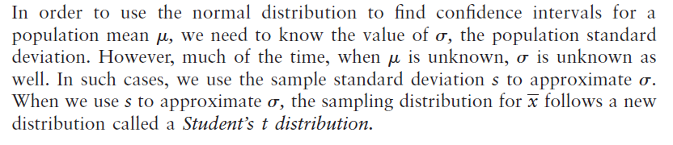
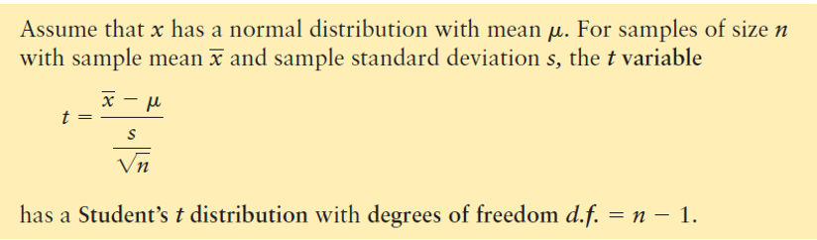
Interval Estimate of Population Mean: σ Unknown
Notes:
3
3

Slide 4
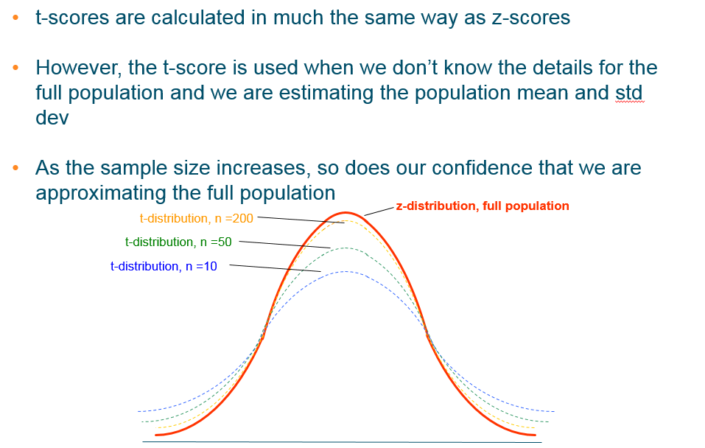
The t-distribution and z-distribution
Notes:
4
4

Slide 5
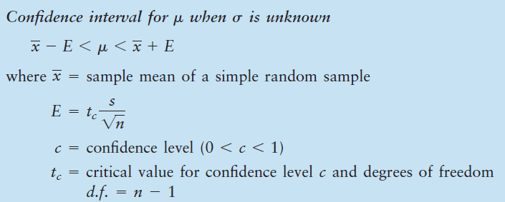
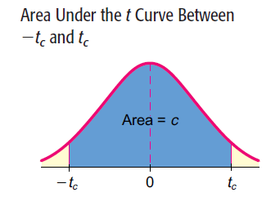
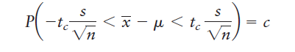
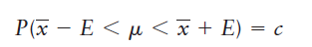
Confidence interval for μ when σ is unknown
Notes:
5
5

Slide 6

Example: Reporting the weather
When weather reporters say “it was 19°C, today”, they wouldn’t bet their lives it was exactly 19°C
Suppose their estimates were based on 25 observations and the mean of these was 19° but the standard deviation was 5°
What would be the range of temperatures if we used a 95% confidence interval?
(the t-score is 2.06 for a sample of 25 using a two-tailed test at 5% probability)
s
CI = x ± (t-score)*
√
n
CI = 19 ± (2.06) * (5 / √ 25)
CI = 19 ± 2.06
95% confident the “real” temperature is between 16.9°C and 21.1°C
Notes:
6
6

Slide 7
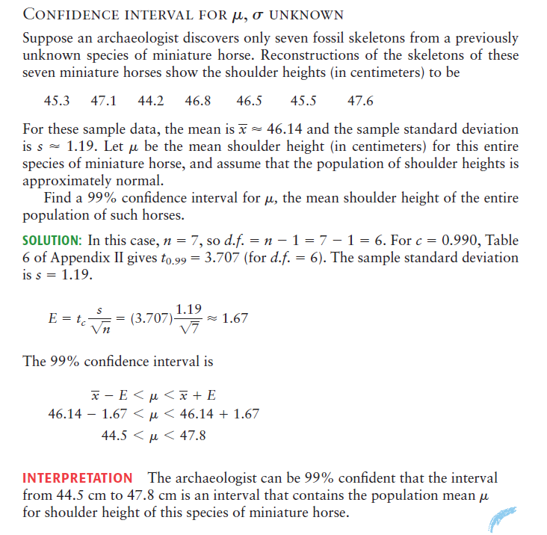
EXAMPLE
Notes:
7
7

Slide 8
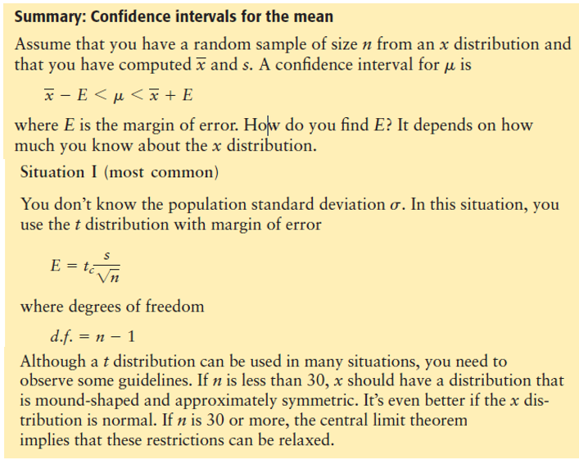
Notes:
8
8

Slide 9
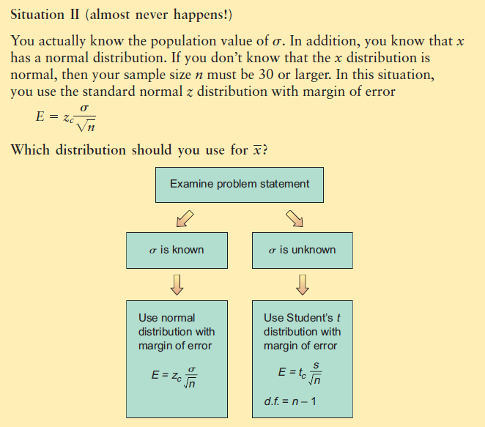
Notes:
9
9

Slide 10
Independent Samples and Dependent Samples

Slide 11
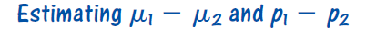
How can we tell if two populations are different? One way is to compare the
difference in population means or the difference in population proportions. In this
section, we will use samples from two populations to create confidence intervals for the difference between population parameters.
To make a statistical estimate about the difference between two population parameters, we need to have a sample from each population. Samples may be independent or dependent according to how they are selected.
Notes:
11
11

Slide 12
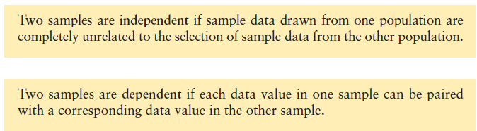
Independent Samples and Dependent Samples
we will use samples from two populations to create confidence intervals for the difference between population parameters.
Notes:
12
12

Slide 13
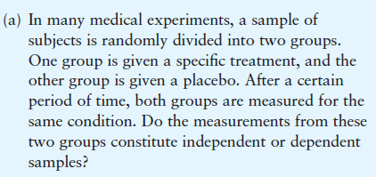
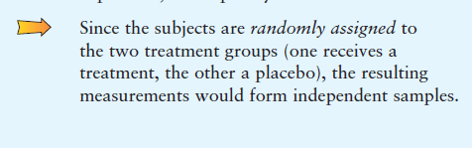
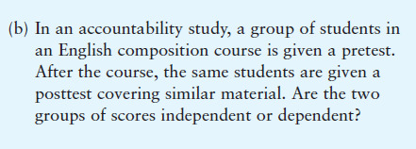
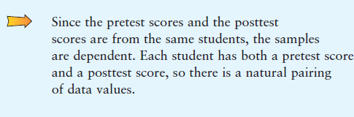
EXAMPLE
Notes:
13
13

Slide 14
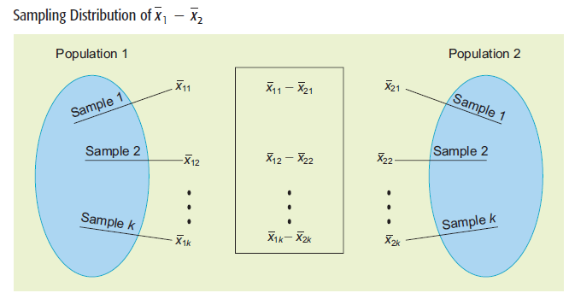
Notes:
14
14

Slide 15
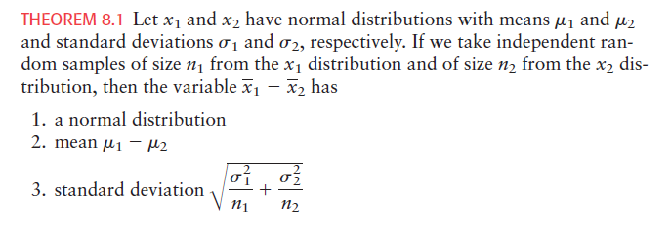
Notes:
15
15

Slide 16
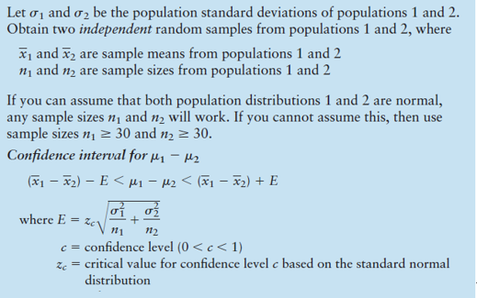
Notes:
16
16

Slide 17
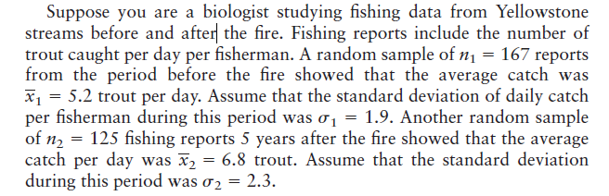
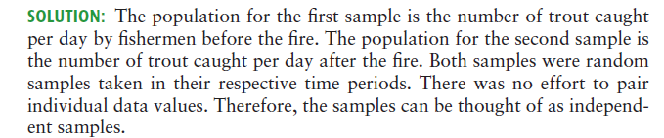
EXAMPLE
Notes:
17
17
1988 yazında, Yellowstone Milli Parkı'nın ünlü yemyeşil akarsuların yakınındaki eski kereste alanlarını tahrip eden bazı büyük yangınları vardı. Balıkçılar, ateşin bu dereler üzerindeki uzun süreli etkilerinden endişe duyuyorlardı. Bununla birlikte, biyologlar ölü ağaçların altında doğacak yeni çayırların çok daha fazla böcek üretebileceğini ve önümüzdeki yıllarda daha iyi balık avlama anlamına geleceklerini iddia etti. Parkta kayıtlı rehberlik hizmetleri yıllar boyu balıkçıların günlük avına ilişkin bilgi sağlamıştır. Akarsu üzerindeki ranger kontrolleri, balıkçılar tarafından yakalanan günlük balık sayısı hakkında da bilgi sağlamıştır. Yellowstone Today (ulusal bir park yayıncısı), biyologların iddiasının temelde doğru olduğunu ve Yellowstone'un avcılarının ortalama artan avına razı olduğunu belirtti. Yangından önce ve sonra Yellowstone derelerinden balıkçılık verileri okuyan bir biyolog olduğunuzu varsayalım. Balıkçılık raporları balıkçı başına günde yakalanan alabalık sayısını içerir.

Slide 18
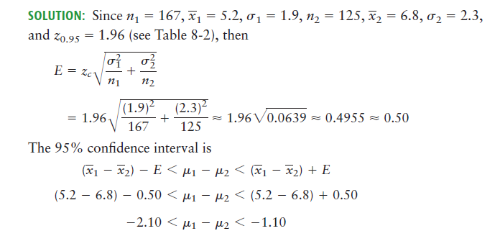
EXAMPLE
Notes:
18
18

Slide 19
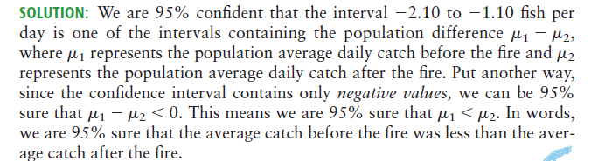
EXAMPLE
Notes:
19
19

Slide 20
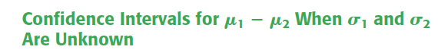
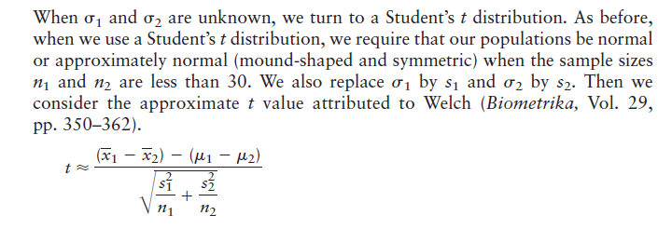
Notes:
20
20

Slide 21
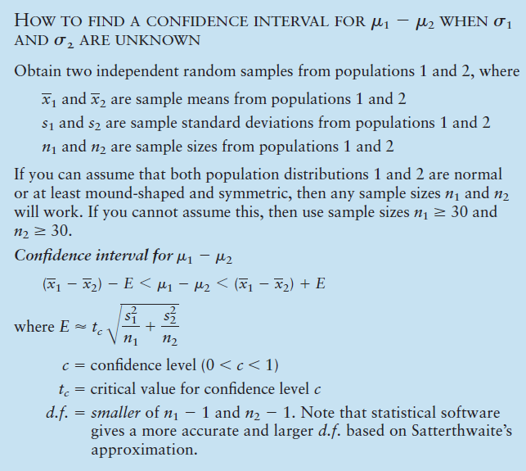
Notes:
21
21

Slide 22
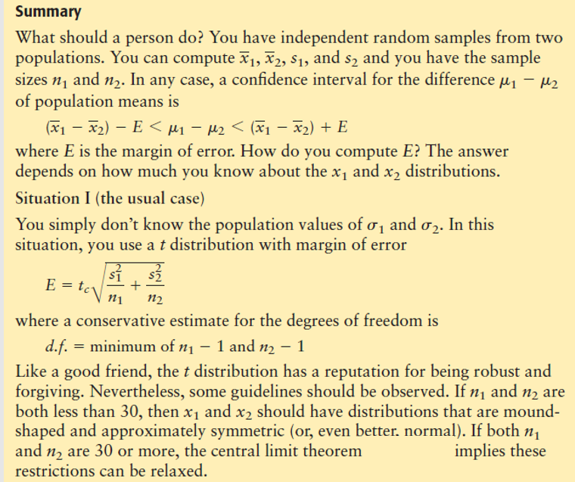
Notes:
22
22

Slide 23
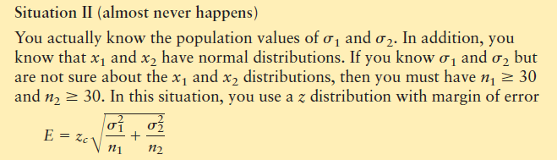
Notes:
23
23

Slide 24
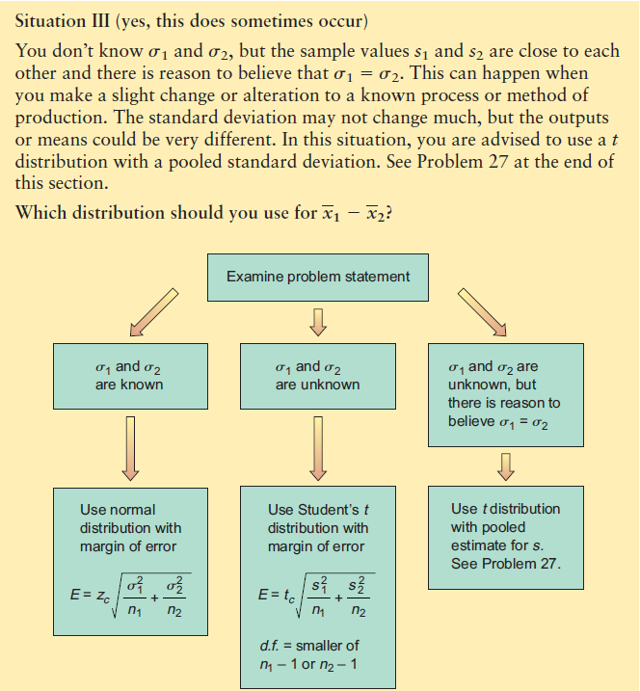
Notes:
24
24

Slide 25
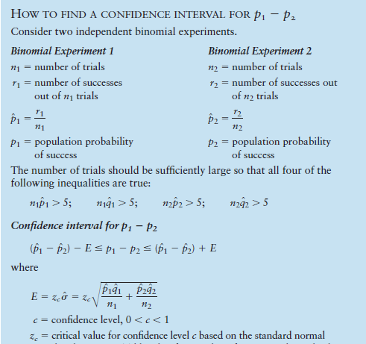
HOW TO FIND A CONFIDENCE INTERVAL FOR p1- p2
Notes:
25
25

Slide 26
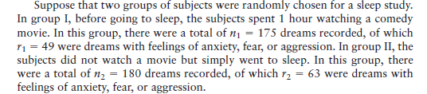
EXAMPLE
Notes:
26
26

Slide 27
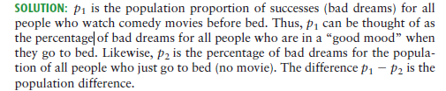
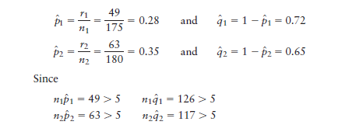
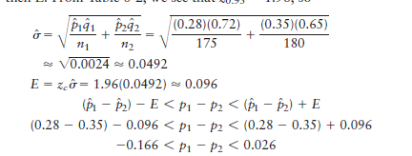
EXAMPLE
Notes:
27
27

Slide 28
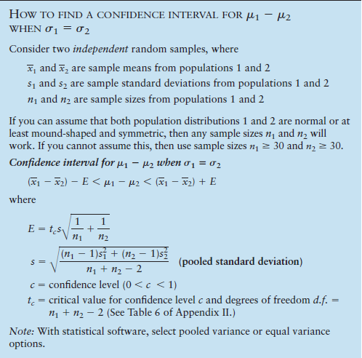
Notes:
28
28

Slide 29
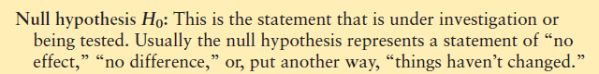
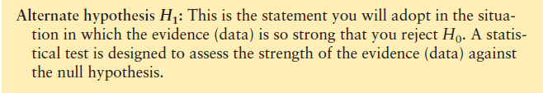
Hypothesis Testing Basics
Null Hypothesis
Alternative
Hypothesis
Notes:
29
29

Slide 30
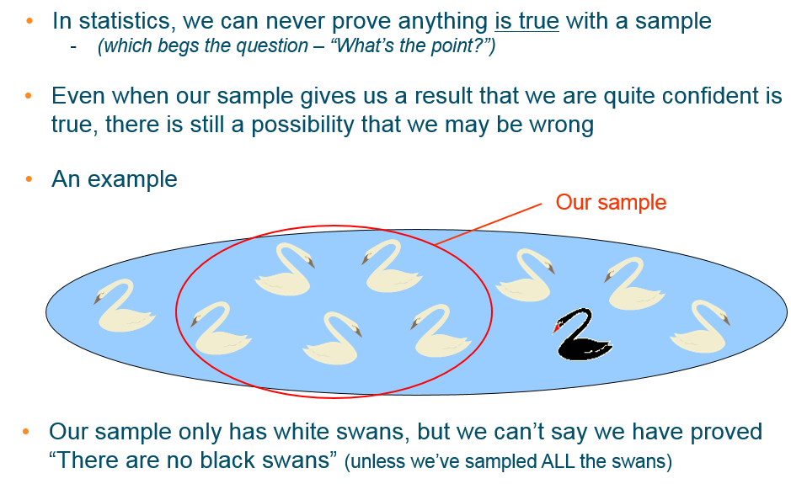
Why do we need hypotheses?
Notes:
30
30
Bizim örneğimizde sadece beyaz kuğular var, ancak ispatladığımızı söyleyemeyiz, ancak bir şeylerin doğru olmadığını kanıtlayabiliriz

Slide 31
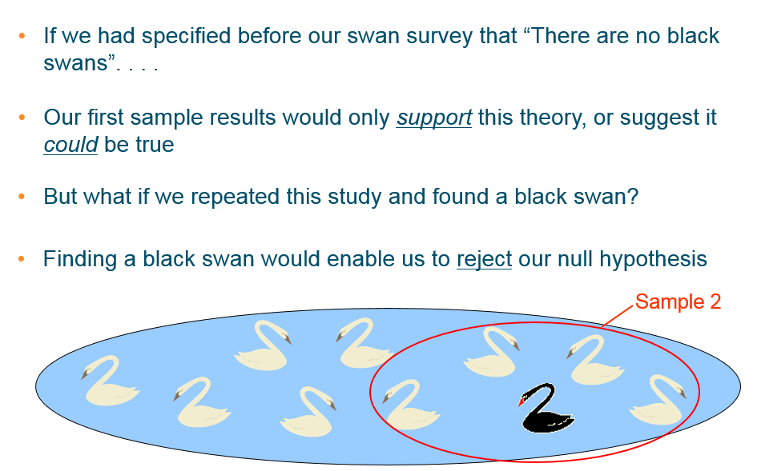
But we can prove something is not true
Notes:
31
31
Bizim örneğimizde sadece beyaz kuğular var, ancak ispatladığımızı söyleyemeyiz, ancak bir şeylerin doğru olmadığını kanıtlayabiliriz

Slide 32
Levels of significance
When testing our data, we are rarely looking for something as clear cut as whether black swans exist. . . (they do, by the way. I’ve seen one)
Usually, we want to compare values for a particular variable between one group and another to see whether any “real” differences or relationships are likely
We have an array of tests for the significance of our results i.e. how confident we are that there are “real” differences or similarities
One standard level of confidence used in statistics is 95%
Only when we are 95% sure that a result is genuine (quite likely it’s not a chance finding), can we accept that it is statistically significant
We can say this another way. . . if there is only a 5% probability of something happening by chance (p≤0.05), we are confident enough to accept it as being true (probably!)
Notes:
32
32

Slide 33
Hypothesis testing stages and steps
Determine the statistical method to be used
Analysis and calculations
State the hypotheses
Null hypothesis – True unless strong evidence
Alternative hypothesis – Challenger
Level of significance – Probability of type I error
Test statistics
Critical values or p-value – Used to convert statistics to a simple comparison
Decision rule – Simple decision
Interpretation of the results
Notes:
33
33

Slide 34
Decision step for hypothesis testing
In hypothesis testing, there are two decisions
Reject H₀:
⁾ There is enough statistical evidence to reject H₀
⁾ There is strong evidence that H₀ is not correct
⁾ It is statistically proven that H₀ is not correct
⁾ NOTE: Rejecting H₀ does not mean H_{a} is accepted
Cannot reject H₀:
⁾ There is not enough statistical evidence to reject H₀
⁾ It is not proven that H₀ is not correct
⁾ Note: It does not mean that H_{a} is rejected
⁾ Note: It does not mean H₀ is accepted
Notes:
34
34

Slide 35
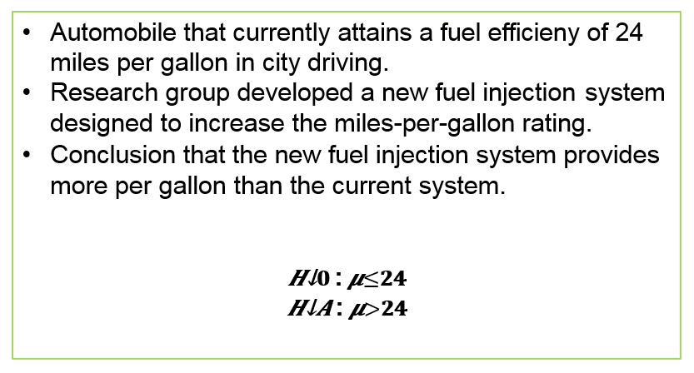
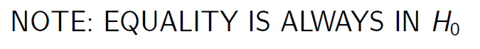
Example
Notes:
35
35

Slide 36
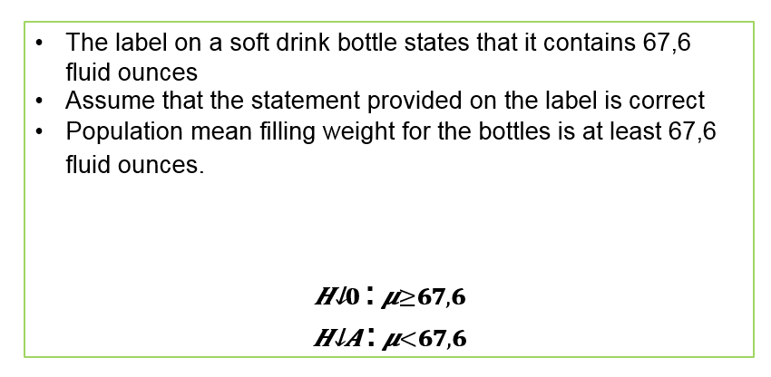
Example
Notes:
36
36

Slide 37
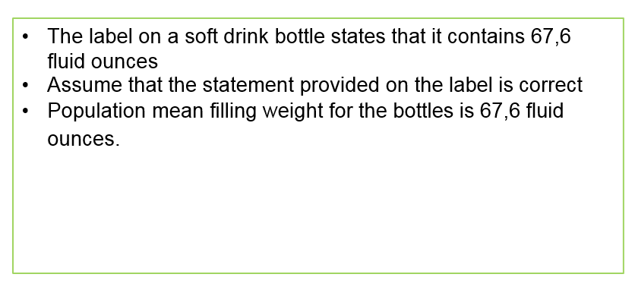
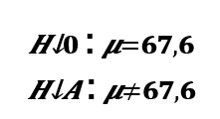
Example
Notes:
37
37

Slide 38
Example
e Research Question: Children who eat oily fish for six months will show a higher IQ increase than children who have not

Slide 39
Example
e Research Question: Children who eat oily fish for six months will show a higher IQ increase than children who have not
e H₀=

Slide 40
Example
e Research Question: Children who eat oily fish for six months will show a higher IQ increase than children who have not
e H₀= Children who eat oily fish for six months do not show a higher IQ increase than children who do not.

Slide 41
Example
e Research Question: Children who eat oily fish for six months will show a higher IQ increase than children who have not
e H₀= Children who eat oily fish for six months do not show a higher IQ increase than children who do not.
e H_{a}=

Slide 42
Example
e Research Question: Children who eat oily fish for six months will show a higher IQ increase than children who have not
e H₀= Children who eat oily fish for six months do not show a higher IQ increase than children who do not.
e H_{a}= Children who eat oily fish for six months will show a higher IQ increase than children who have not.

Slide 43
Example
e A new teaching method Flipped learning is developed that is believed to be better than the current method

Slide 44
Example
e A new teaching method Flipped learning is developed that is believed to be better than the current method
e H₀= The flipped learning method is not better than the current method.

Slide 45
Example
e A new teaching method Flipped learning is developed that is believed to be better than the current method
e H₀= The flipped learning method is not better than the current method.
e H_{a}= The flipped learning method is better.

Slide 46
Example
e
A new drug is developed with the goal of lowering blood pressure more than the existing drug.

Slide 47
Example
e
A new drug is developed with the goal of lowering blood pressure more than the existing drug.
e H₀= The new drug does not provide lower blood pressure than the existing drug.

Slide 48
Example
e
A new drug is developed with the goal of lowering blood pressure more than the existing drug.
e H₀= The new drug does not provide lower blood pressure than the existing drug.
e H_{a}= The new drug lowers blood pressure more than the existing drug.

Slide 49
Example
e
A production line operation is designed to fill cartons with detergent to a mean weight of 3 kilograms and underfilling or overfilling is not desired.

Slide 50
Example
e
A production line operation is designed to fill cartons with detergent to a mean weight of 3 kilograms and underfilling or overfilling is not desired.
e H₀= The detergent cartons weight exactly 3 kilograms.

Slide 51
Example
e
A production line operation is designed to fill cartons with detergent to a mean weight of 3 kilograms and underfilling or overfilling is not desired.
e H₀= The detergent cartons weight exactly 3 kilograms.
e H_{a}= The detergent cartons do not weight 3 kilograms.

Slide 52
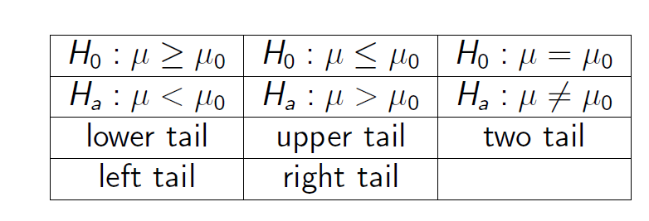
Forms for Null and Alternative Hypotheses

Slide 53
Type I and Type II errors
Null Hypothesis
(predict there will
be no significant result)
Type I error
We incorrectly reject the null hypothesis
(or accept the alternative), believing there
is a genuine effect in our population, when
in fact, there isn’t
Alternative
Hypothesis
(predict there will
be significant result)
Type II error
We incorrectly reject the alternative
hypothesis (or accept the null), believing there
is no effect when our sample just hasn’t
detected it
Notes:
53
53

Slide 54
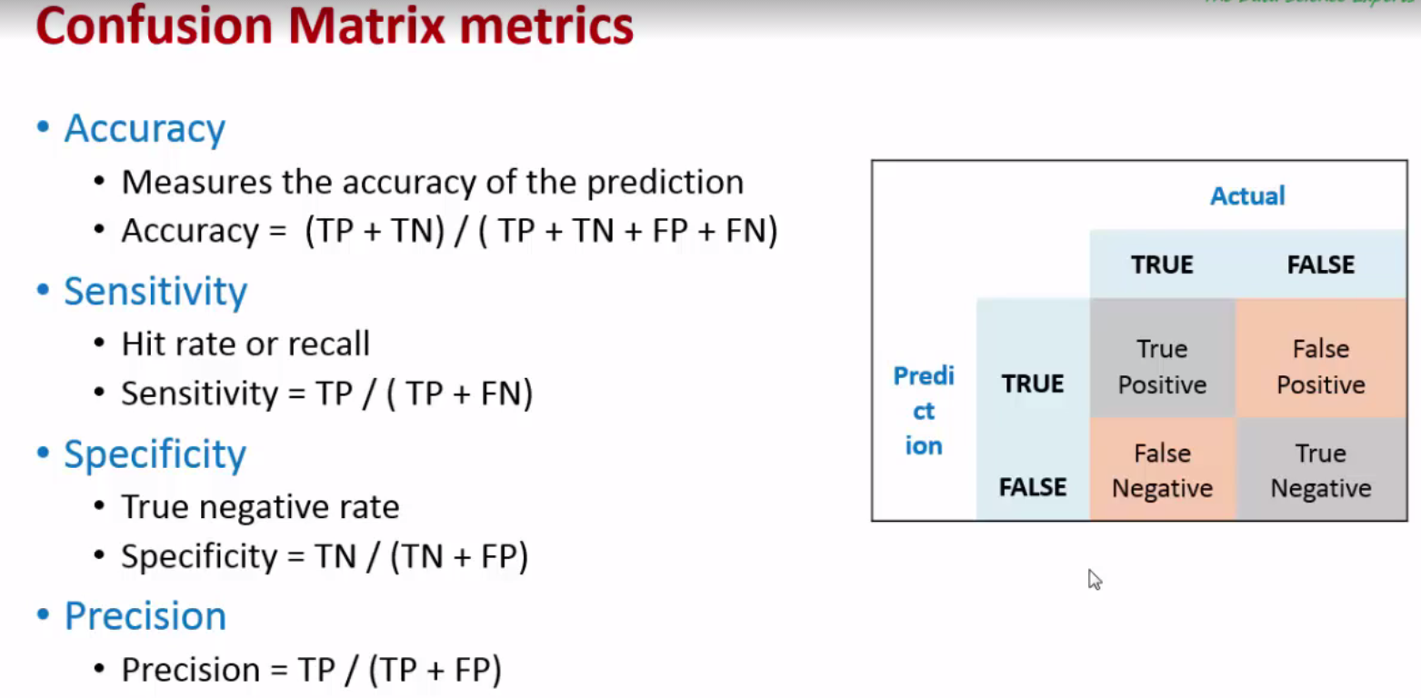
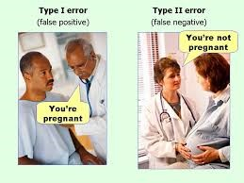
Notes:
54
54

Slide 55
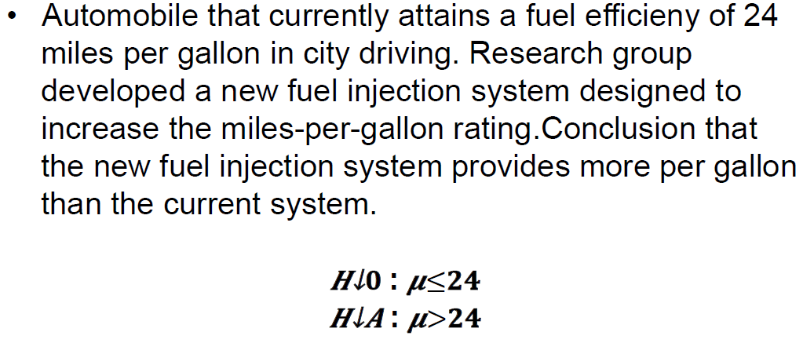
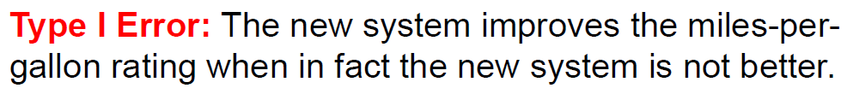
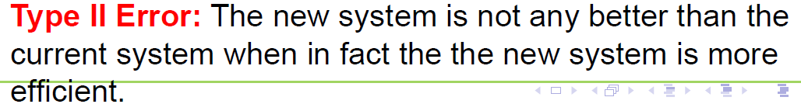
Type I and Type II errors
Notes:
55
55

